Slide 1
City Classified and Search System

Slide 2
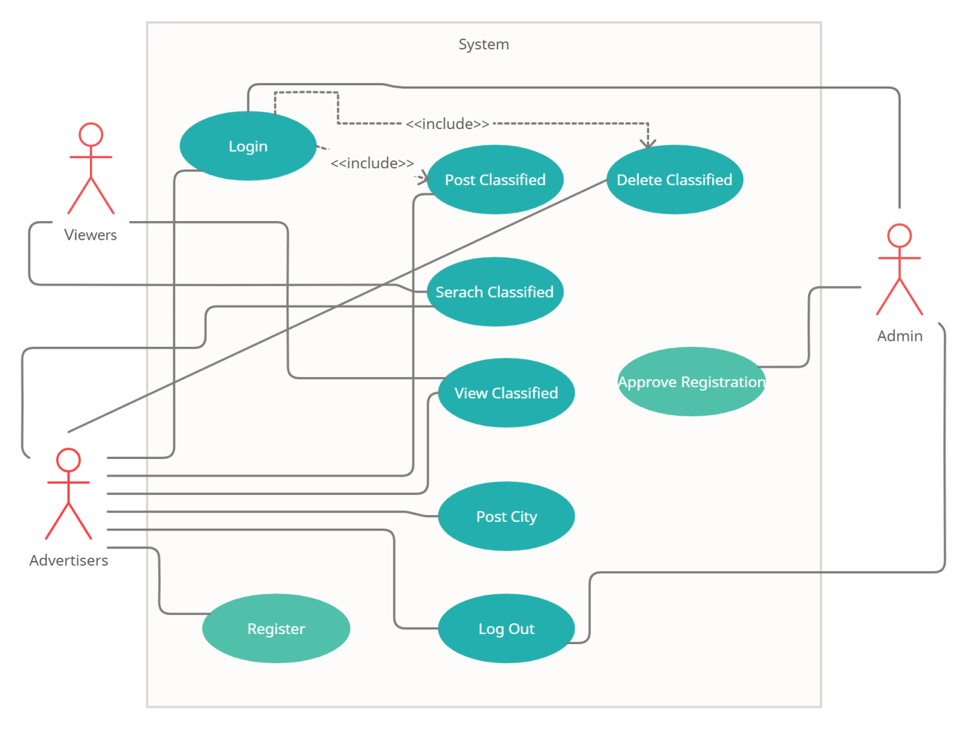
Use Case Diagram

Slide 3
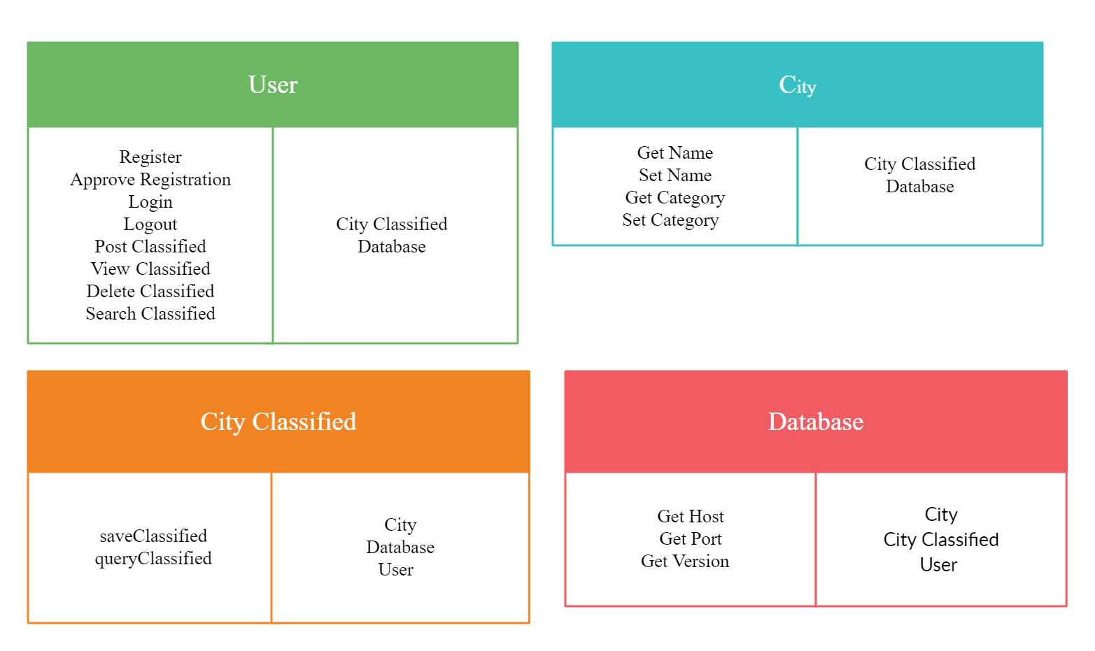
CRC Diagram

Slide 4
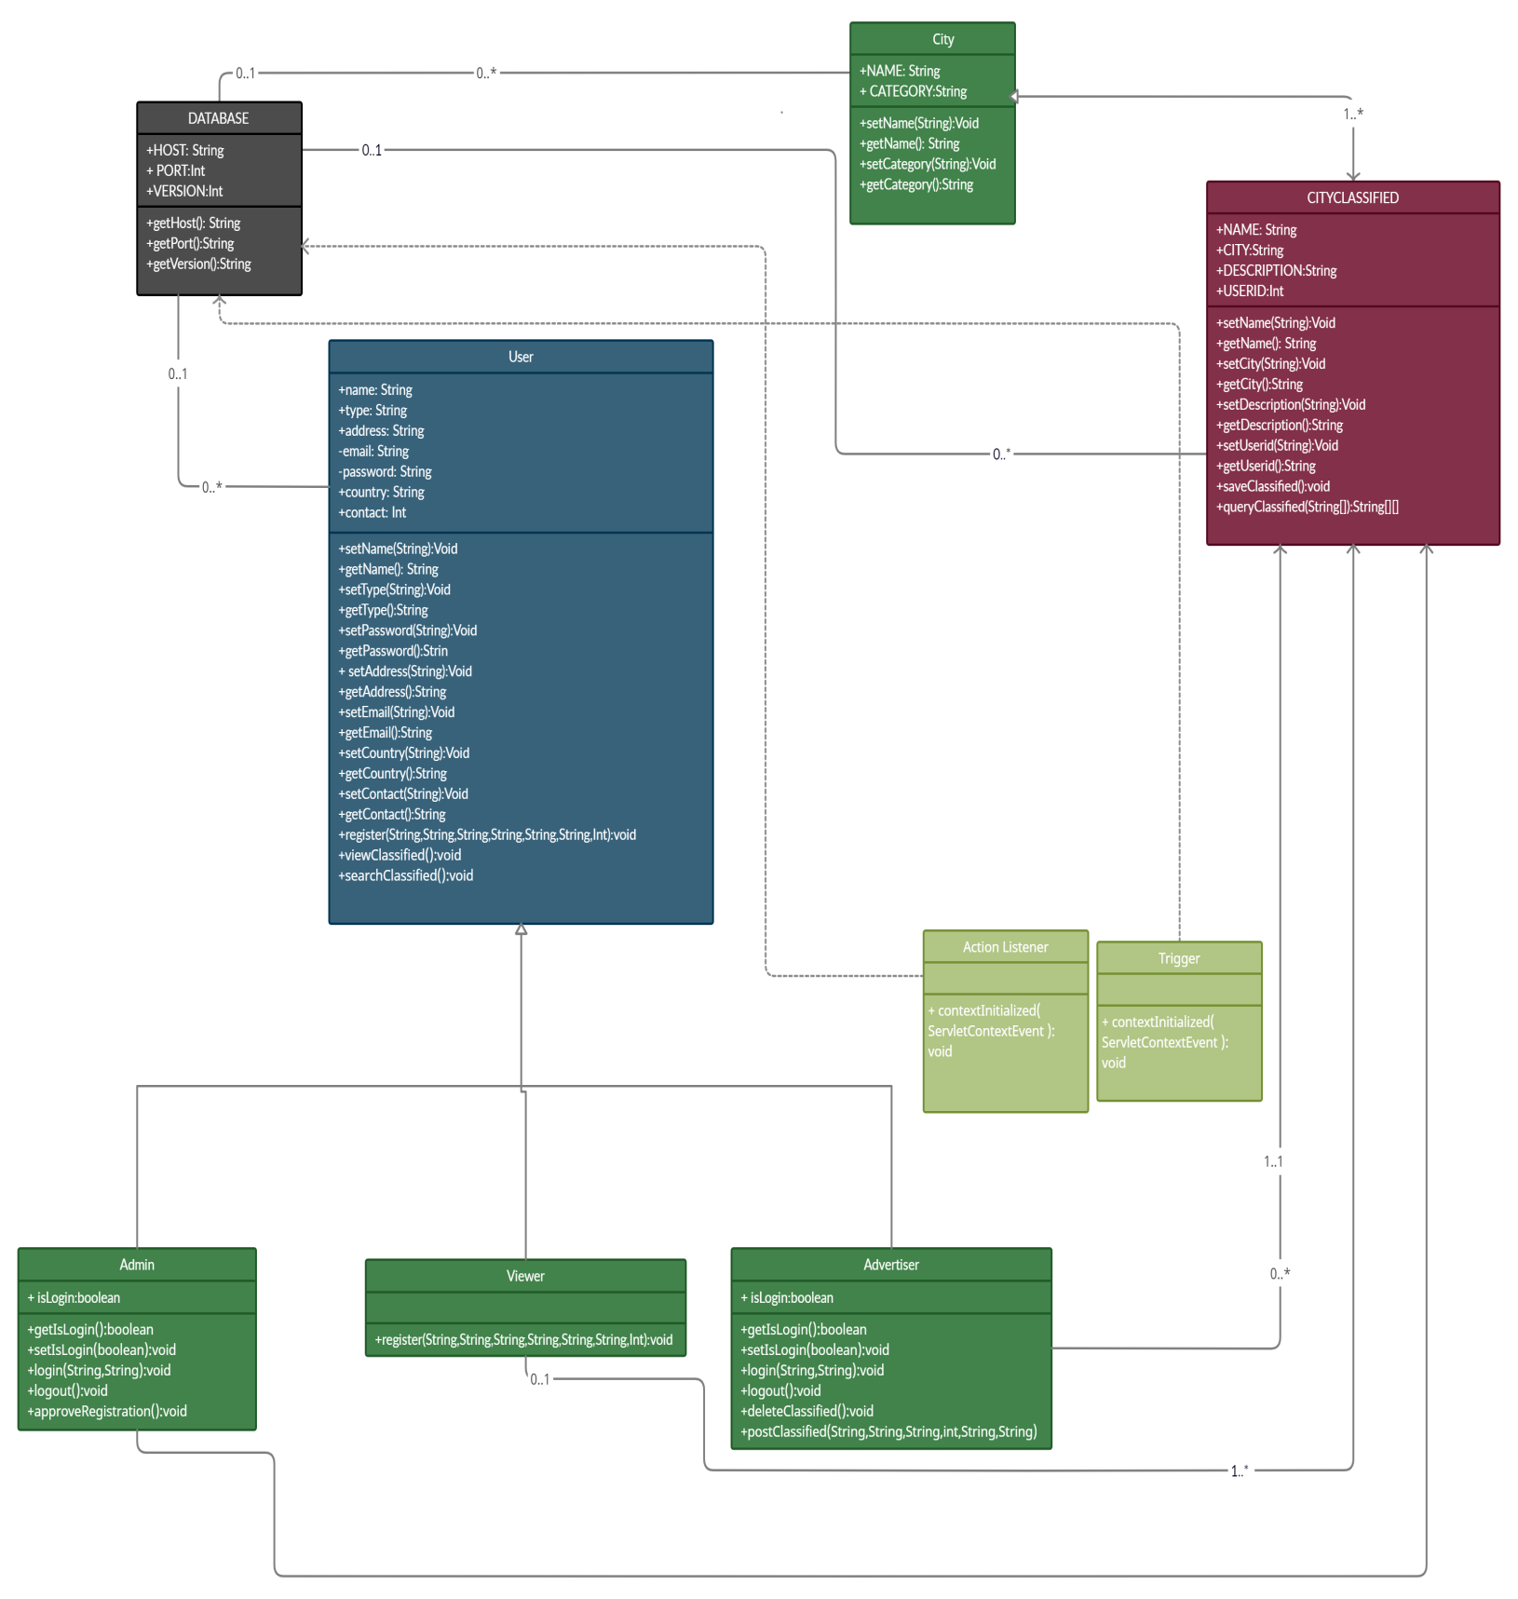
Class Diagram

Slide 5
Technology Used
Frontend: HTML5, JavaScript, CSS, JQuery
Backend: Java, Servlets, JSP
Database: Oracle 10g express
Server: Tomcat 7

Slide 6
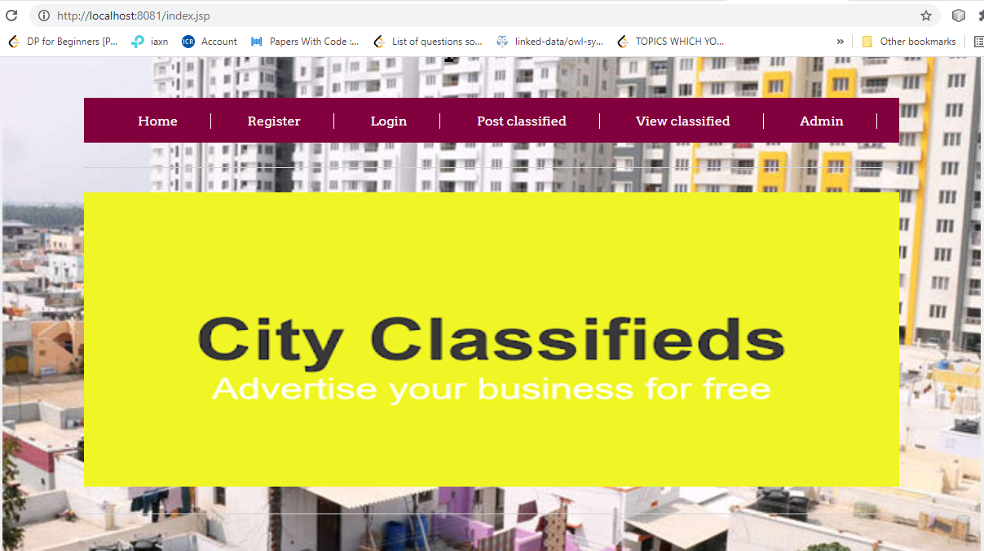
Snapshots

Slide 7
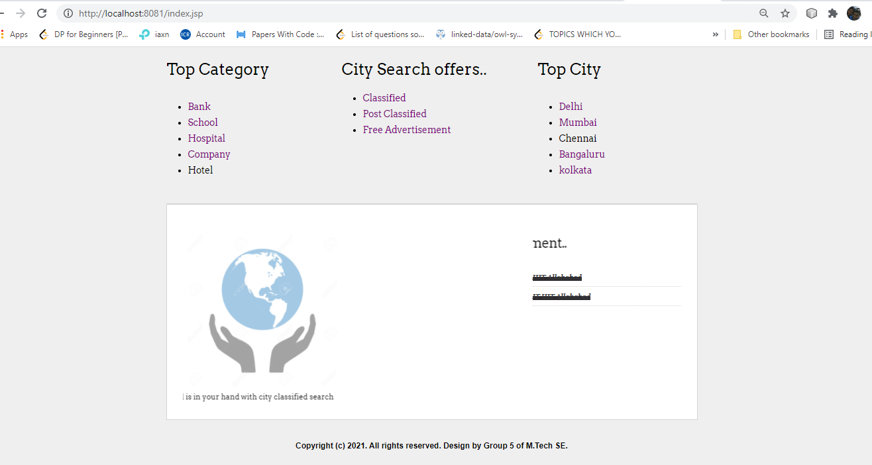
Index

Slide 8
Index
Home page of the project
Here we can view classified
Admin can login
Advertiser can login
Advertiser can register if not already registered.

Slide 9
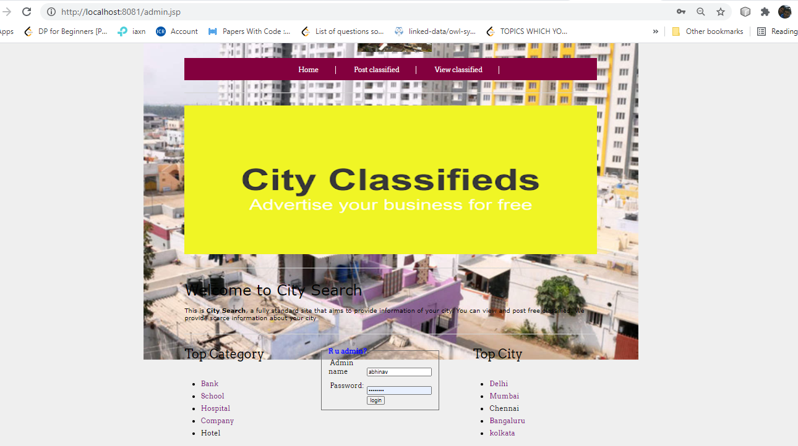
Admin login

Slide 10
Admin login
A single admin.
Admin can login using its username and password.
Admins username and password can only be changed by developer.

Slide 11
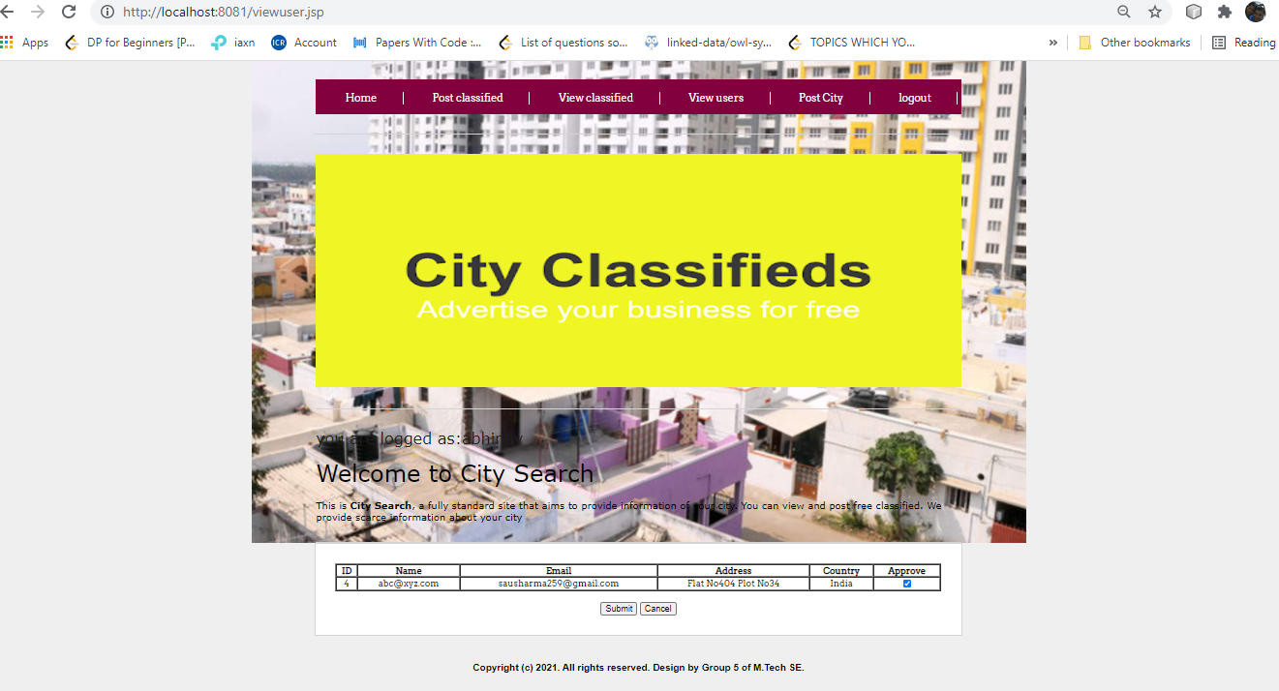
Approval of User

Slide 12
Approval of User
Whenever a new user wants to register they need approval of admin.
After approval from admin only they are allowed to post classifieds.
User can register using registration page provided separately.

Slide 13
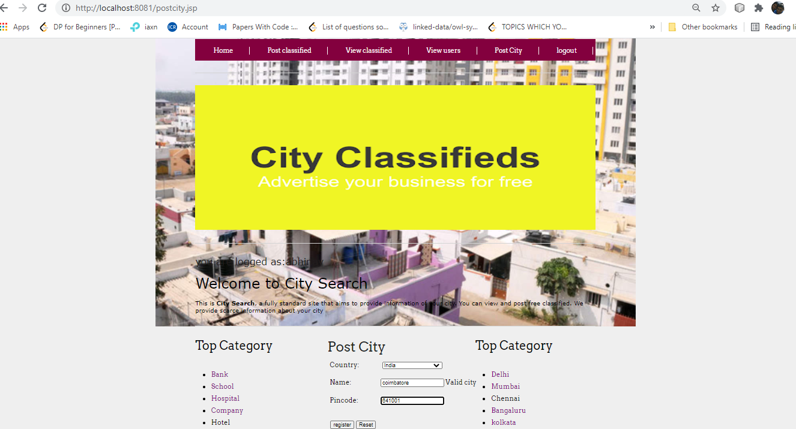
Post City

Slide 14
Post City
To add classified city wise, city must be present.
This functionality is given to admin only.
Only when a city is added then its classifieds can be added.

Slide 15
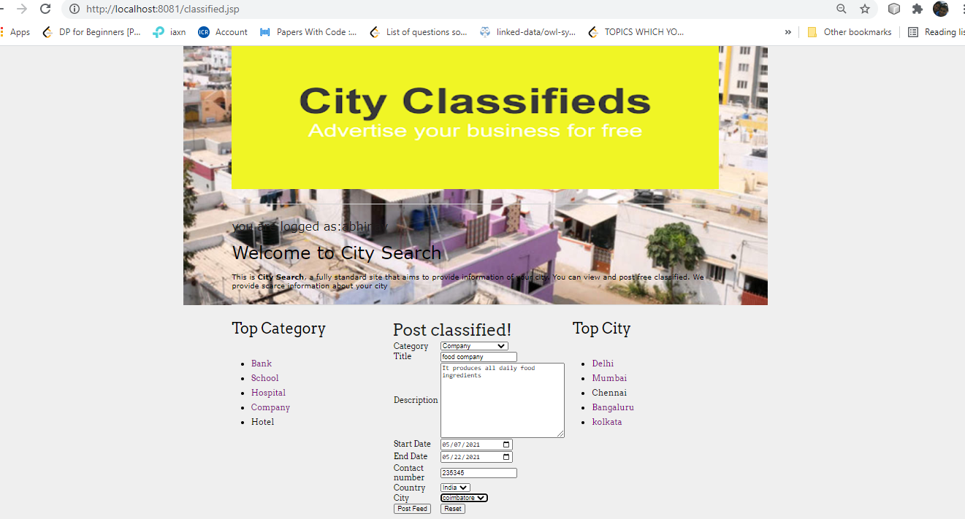
Post Classified

Slide 16
Post Classified
Once advertiser is approved by admin they can post classifieds.
For adding classifieds city must be already present.
Details required for classified: Category, Title, Description, Start and End Date, Contact Number, Country, City.
Once country is chosen all existing city will be shown itself

Slide 17
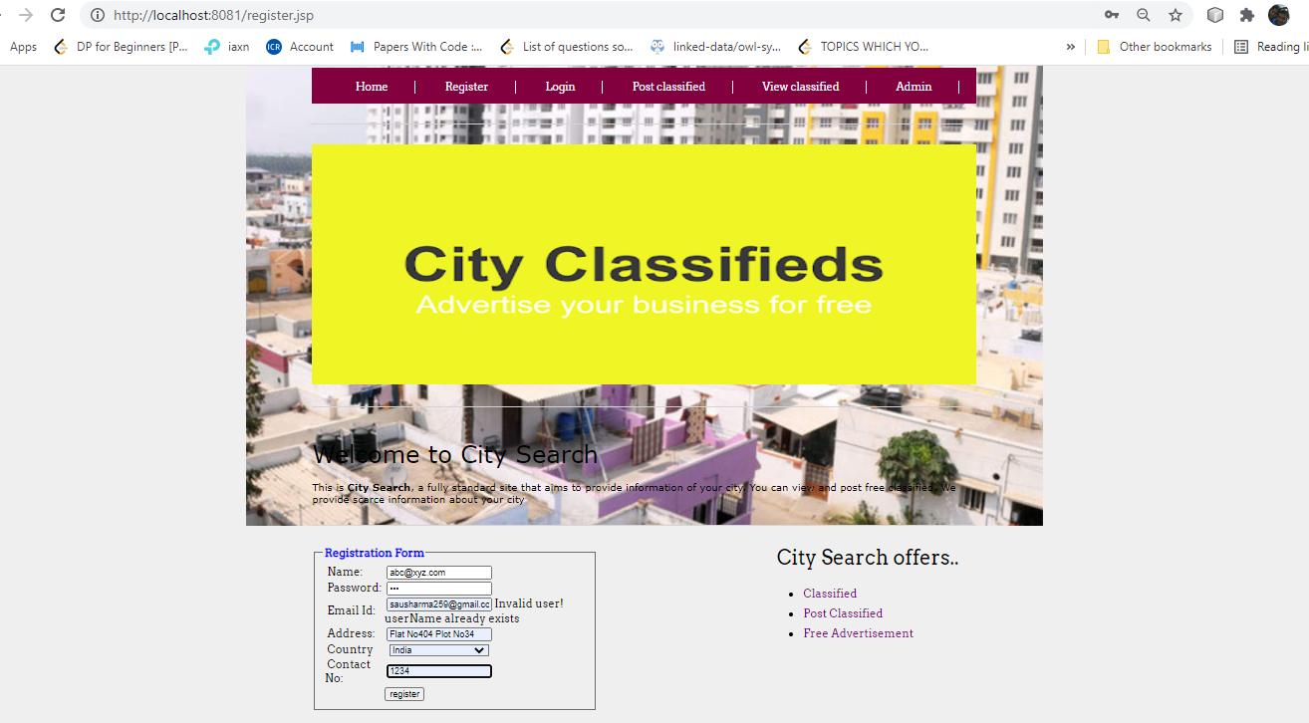
Advertiser Registration

Slide 18
Advertiser Registration
Details required for registration- Name, Password, Email Id, Address, Country, Contact No.
This is prerequisite for adding classified.
Same credentials scant be used for registration.

Slide 19
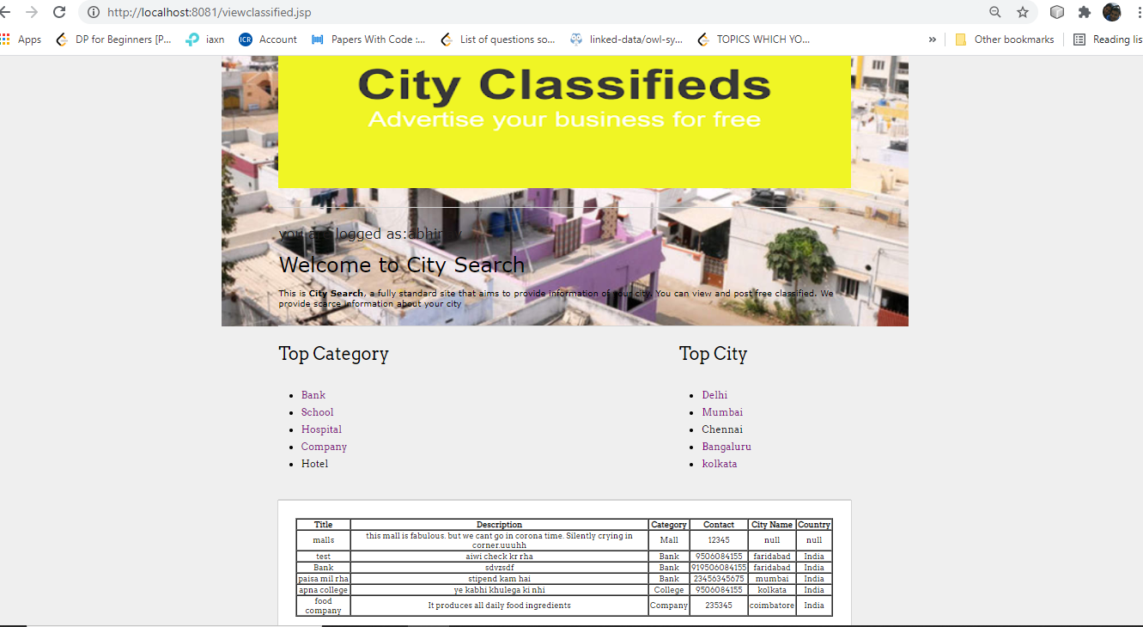
View Classified

Slide 20
View Classified
Anyone can view classified.
Start date – Date when the classified will start to be displayed.
End Date – Date when classified will be removed. It helps in dynamically removing classifieds.
City and Category – Classified which will be used to categorize the classifiers.
Contact – Advertisers contact information

Slide 21
Logout
Admin once verifies the user and adds the city can logout and his session will end.
Advertiser also can logout once he posted his classified.
As soon as they logout their access session ends.

Slide 22
Future Scope
Category upon which classified can be categorized can be increased.
Deletion can be added before completion date, when other policies are considered.
Exact location of property can be shared with Google map API.
More than one admin can be added if number of users increase.

Slide 23
THANK YOU

